Slide 1

Chemistry 125: Lecture 65
April 4, 2011
Addition to C=O Mechanism & Equilibrium
Protecting Groups
Imines
This
For copyright notice see final page of this file

Slide 2
Basic Carbonyl Reactivity
1) Addition to C=O (initial nucleophile attack)
2) Addition to C=O (acid catalysis)
3) Allylic rearrangement to enol (acid-catalyzed or via enolate)
4) α-Substitution
5) Nucleophilic substitution of acid derivatives
O
H
A
R₂C
C
R
L
Nu
R
A
Nu
H

Slide 3
RCOOH Reactions (sec. 20.7, pp. 964-965)
O
A
addition
R
C
substitution
at C
O
H
R
R
H
Nu
substitution
at α-C
substitution
at O

Slide 4
Fischer Esterification (sec. 20.8, p. 965)
(acid catalyzed)
Why protonate this oxygen
instead of
this one?
+
starts with
addition
to C=O
H
+
O
H
+
R
C
analogous to nucleophilic aromatic substitution
substitution
at C
and is stabilized still more after protonation on top
because this pair was stabilized by π*
+
OR
O
H
O
H
RO
NO₂
+
H
+
H
H
NO₂
+
Tetrahedral Intermediate
(A/D, not the pentavalent transition state of S_{N}2)
RNH₂
F

Slide 5
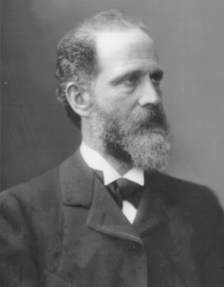
Victor Meyer 9/8/48 - 8/8/97
“Geliebte Frau! Geliebte Kinder! Lebt wohl! Meine Nerven sind zerstört; ich kann nicht mehr.”
Victor Meyer
(1848 - 1897)
introduced
the idea of
Steric
Hindrance
(1894)
“…the source of this behavior is stereochemical…the space filling of the neighboring groups”
Configuration
van’t Hoff (1874)
Strain
Baeyer (1885)
Conformation
Sachse (1891)
Notes:
Ber, 27, 510, 1585, 3146 (1894)

Slide 6
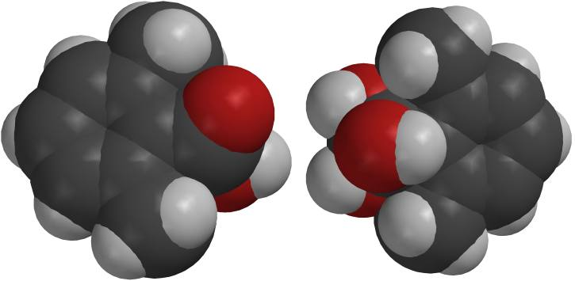
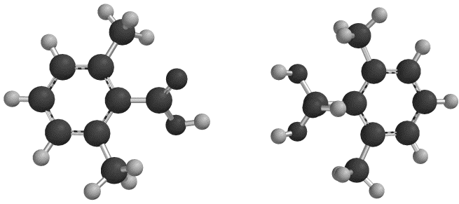
Fischer Esterification Didn’t Work
with 2,6-Dimethylbenzoic Acid
Carboxylic Acid
Tetrahedral Intermediate
STRAIN!

Slide 7
Melvin Newman’s Method (1941)
Fischer Esterification (sec. 20.8, p. 965)
Linear Acylium Intermediate
(D/A, like S_{N}1)
Tetrahedral Intermediate
(A/D)
+
R
O
H⁺
+
R
C
O
substitution
at C
+
O
H
OR
H⁺
+
+
H
H
+
H
O H
(attaching second H⁺ inhibits reversal)
Pour into ROH
sometimes
H
100% H₂SO₄

Slide 8
Hydration (acid or base)
(e.g. J&F Sec. 16.6-16.7) imine2amino acid

Slide 9
Base-Catalyzed Hydration of Formaldehyde
HO⁻
H-O-H
HO
HO
O=CH₂
CH₂
CH₂
+ HO⁻
⁻O
HO
Acid-Catalyzed Hydration of Formaldehyde
+
HOH
+
H
H
H
HOH
+
HO
+
H-O-CH₂
CH₂
+
HO
(Hydrate, gem-diol)
HO
CH₂
O=CH₂
O=CH₂
HO
HOH

Slide 10
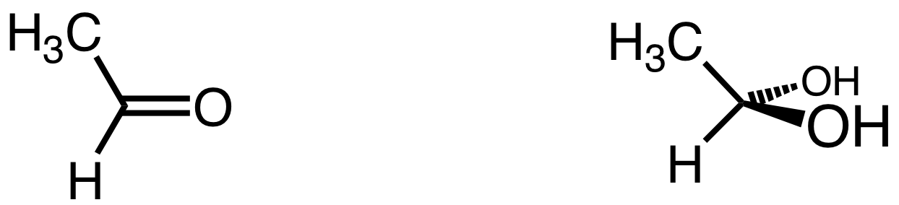
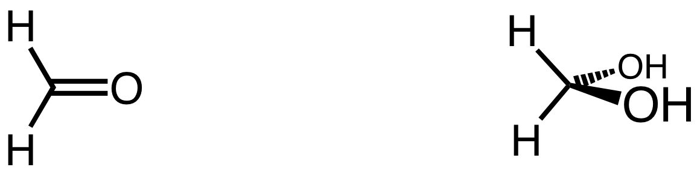
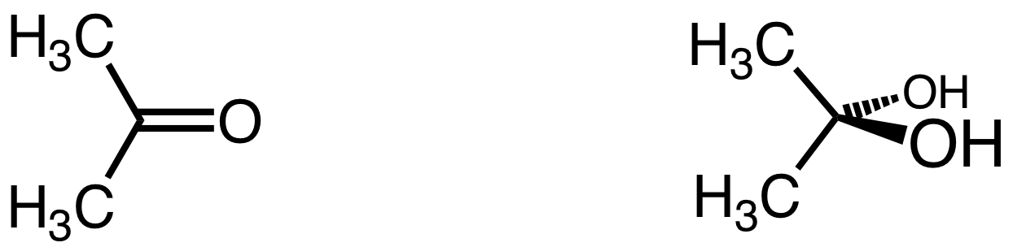
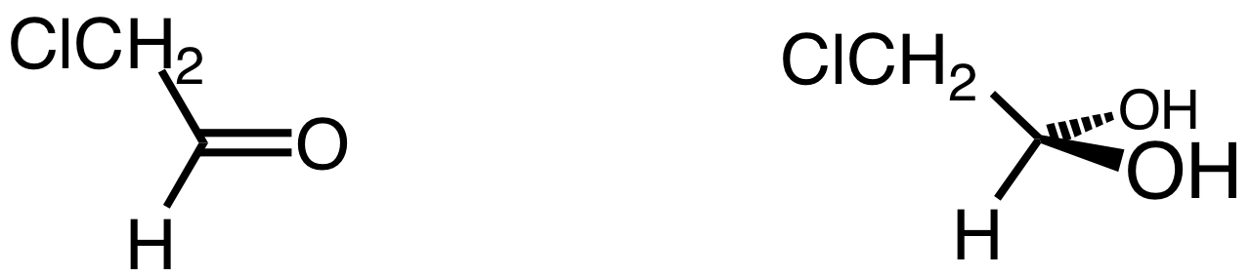
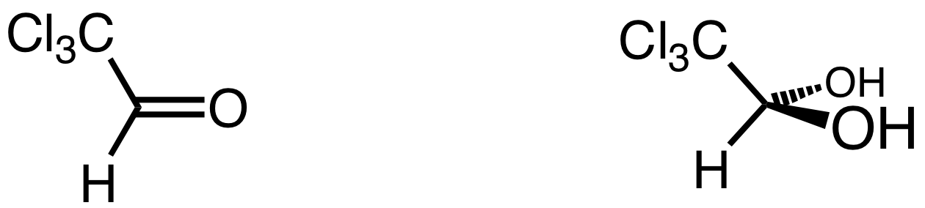
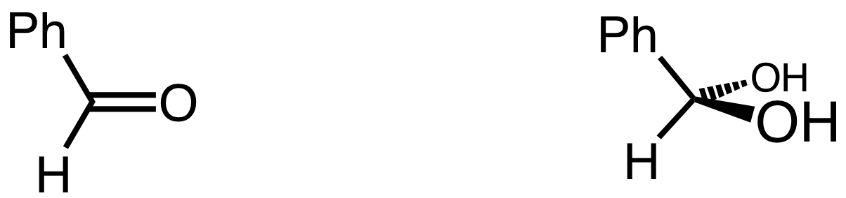
Hydration Equilibrium Constant
K
1
H₂O
+
bond strength
sp²-H < sp²-C
(destabilize CH₂O)
2.3 × 10⁴
smallness
stabilizes
hydrate
2 × 10⁻³
electron donation
sp³ > sp²
(stabilize hydrate)
37
28 × 10³
37² = 1369
conjugation
stabilizes
aldehyde
0.01
Notes:
bond energies from Reusch http://www.cem.msu.edu/~reusch/OrgPage/bndenrgy.htm (Streitwieser, Heathcock, Kosower)

Slide 11
Acetal Formation (acid only)
(e.g. J&F Sec. 16.9)
cyclic

Slide 12
Base-Catalyzed Hemiketal from Formaldehyde
RO⁻
R-O-H
Ether inert to base,
can only reverse!
RO
RO
O=CH₂
CH₂
CH₂
+ RO⁻
⁻O
HO
no way to get to ketal
or to attack ketal
Acid-Catalyzed Hemiketal from Formaldehyde
+
ROH
+
ROH
H
H
H
+
(Ketal)
RO
RO
+
- H₂O
+
- H⁺
H-O-CH₂
CH₂
+
R-O-CH₂
CH₂
HO
RO
+
can attack either O
H
RO
reverse or continue
(Hemiketal)
CH₂
O=CH₂
O=CH₂
HO
HOR

Slide 13
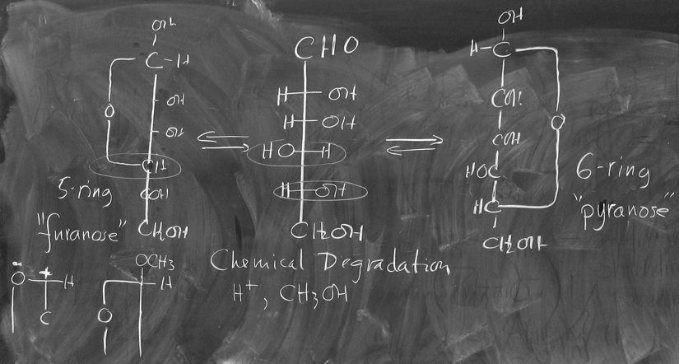
Protecting Groups (& deprotection)
(e.g. J&F Sec. 16.10)
protect C=O as ketal

Slide 14
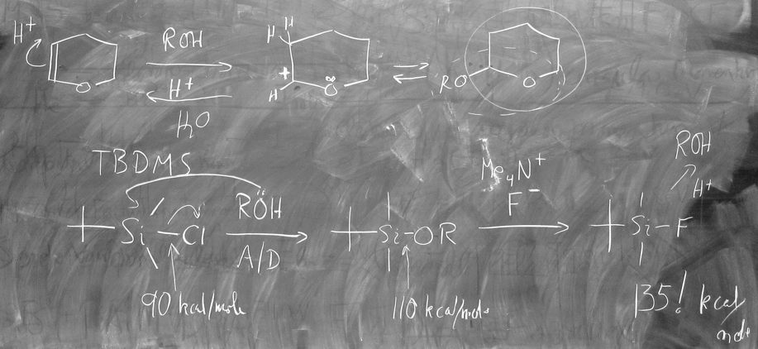
Protecting Groups (& deprotection)
(e.g. J&F Sec. 16.10)
protect C=O as ketal
protect ROH as THP or TBDMS derivative

Slide 15
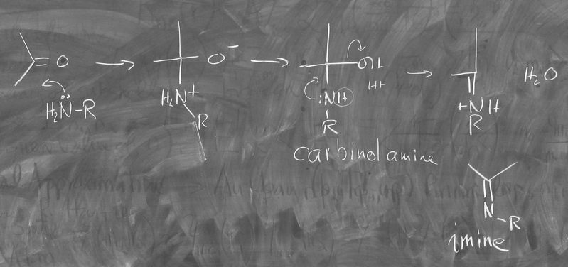
Imines (e.g. J&F Sec. 16.11)

Slide 16
End of Lecture 65
April 4, 2011
Copyright © J. M. McBride 2010. Some rights reserved. Except for cited third-party materials, and those used by visiting speakers, all content is licensed under a Creative Commons License (Attribution-NonCommercial-ShareAlike 3.0).
Use of this content constitutes your acceptance of the noted license and the terms and conditions of use.
Materials from Wikimedia Commons are denoted by the symbol .
Third party materials may be subject to additional intellectual property notices, information, or restrictions.
The following attribution may be used when reusing material that is not identified as third-party content:
J. M. McBride, Chem 125. License: Creative Commons BY-NC-SA 3.0

